Slide 1




CT Early Childhood Facilities Grant Program
Notes:
Presenter
2025-10-19 18:41:15
--------------------------------------------
We are happy to present information about the 2025 Early Childhood Construction and Renovation Grant Opportunity.
Through this program the Office of Early Childhood will be increasing infant and toddler spaces, in communities across CT.
LISC CT is excited to present this new grant program.

Slide 2


Who is LISC?
Together with residents and partners, LISC forges resilient and inclusive communities
of opportunity across America—
great places to live, work, visit, do business and raise families.
Notes:
LISC stands for Local Initiatives Support Corporation. We are a national, non-profit Community Development Financial Institution-
basically we operate as a bank, providing loans and facilitating the distribution of grants throughout the country.

Slide 3







Our Team
The LISC Connecticut Childcare Team is comprised of three main staff members.
LISC Connecticut works in collaboration with our National LISC Team, Advisory Committee, and the Office of Early Childhood to ensure grants are written and managed in compliance with all state and federal regulations.
Elizabeth Fraser
Program Officer
Maxiel Sanchez
Program Officer
Kadeem Mckoy
Assistant Program Officer
3
Notes:
Our team includes Liz Fraser and Maxiel Sanchez who oversee the program development and management of the early childhood grant program. Kadeem McKoy provides technical support to the applicants and grantees we work with, and to the LISC team.

Slide 4
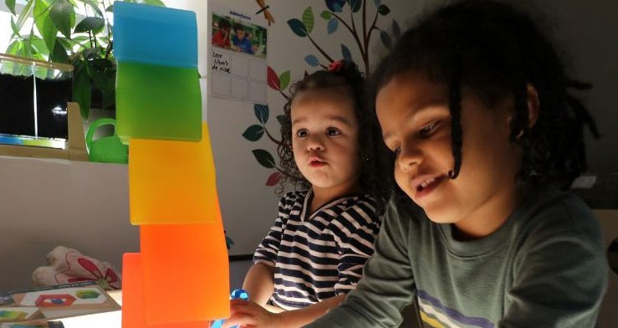
Facilities Grant Program:
Bond Funded
Notes:
--------------------------------------------
This new grant opportunity is funded through State of Connecticut general obligation bonds. $5.25 million dollars is available to distribute through grants. The program has a two-year timeline.
To be clear, this grant opportunity is not funded by the 80. million dollars that will become available in the future, but will help us to prepare for future funding.

Slide 5
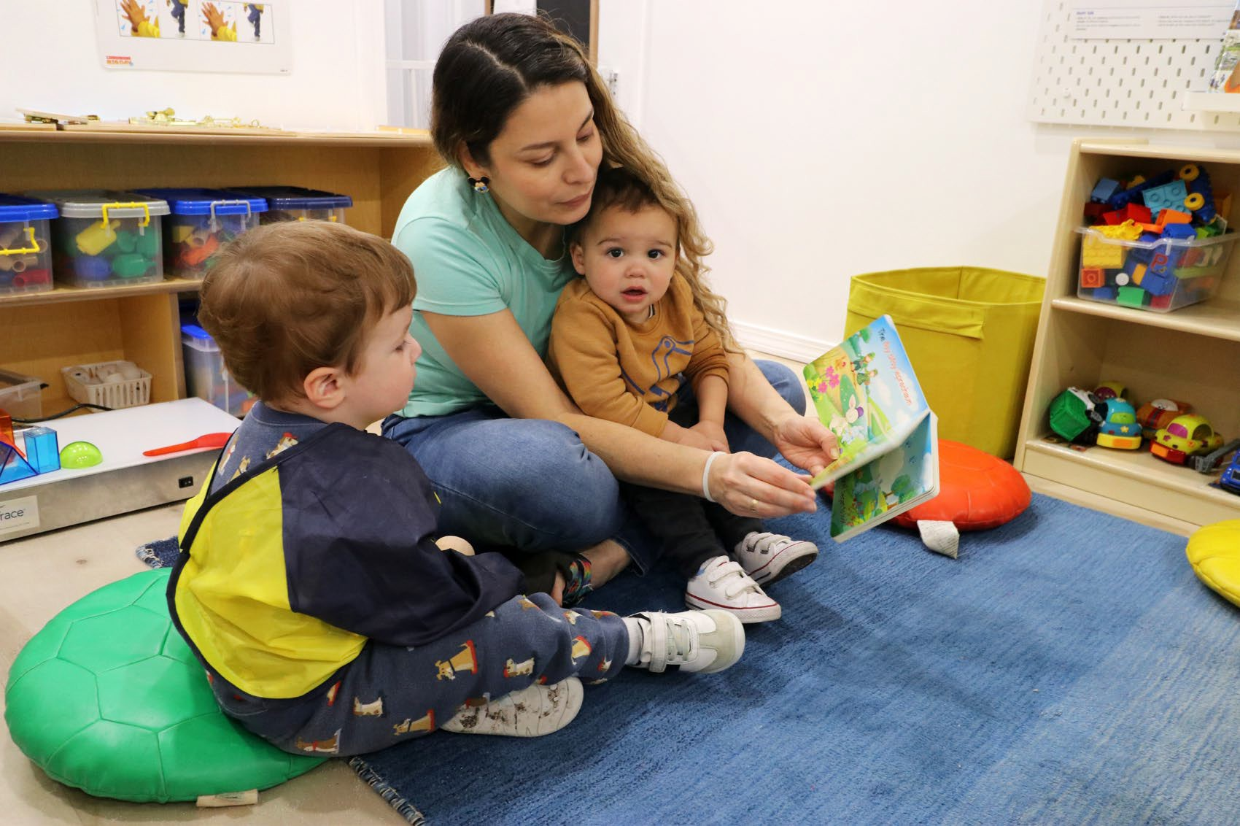
2025 Early Childhood Facilities Grant Program
Overview of the program:
Funded by State of Connecticut general obligation bonds.
Priority of increasing Infant and Toddler capacity in areas of high need, and/or early care deserts.
Preschool capacity in preschool deserts.
$5.25M will support 8-10 projects.
Grant awards will range from $250,000 to $1M.
Shovel ready projects to be prioritized
Notes:
The Grants will range between $250,000 and $1,000,000.
This grant opportunity will fund 8-10 shovel ready grant projects..
Communities that are lacking infant and toddler capacity or are located in a preschool desert will have increased priority in the selection process.
This grant round is not intended for quality improvements, health and safety violations, or for a project that will not increase capacity of existing program.

Slide 6

Bond Program Requirements
Important program requirements to note:
10-year liens required on property for projects over $50,000.
External construction monitoring to ensure all appropriate bonding requirements are followed.
Grantees will need to provide proof of payment for reimbursement – funds will not be able to be disbursed in advance of work.
Notes:
Bonding funds must be managed differently than the ARPA funds, so there will be some differences in this program, compared to the previous ARPA funded program.
Bonding requirements include:
10-year liens on property for projects over $50,000. The projects that will be eligible for this funding will all need to have a property lien, renters will need to discuss with their landlords.
Reimbursement payments/not beneficiary status.
Construction monitoring to ensure all appropriate bonding requirements are being followed.

Slide 7
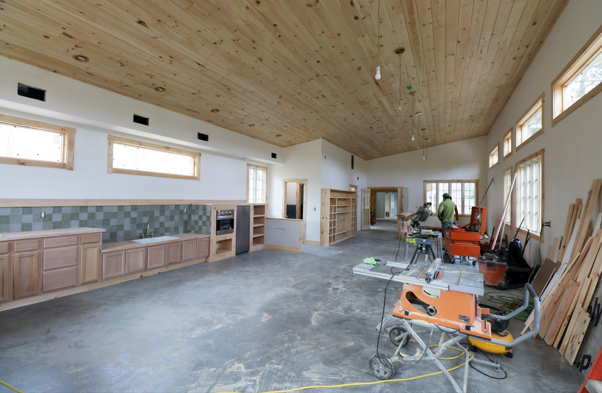
Grant Eligibility
Must be located in Connecticut.
Must be a center-based project, or family incubator project.
Programs must prioritize children in low- or moderate-income families
Projects must have a “program operator” in place.
The operator must be in good standing with the State of Connecticut and with the CT Office of Early Childhood Licensing Department.
Notes:
This is a State of Connecticut program and all sites must be located in Connecticut.
This program prioritizes center-based projects.
The program and potential slots will prioritize low or moderate income families, using such measures as Care4KidsEligible or ALICE family ( Asset limited, Income, Constrained, Employed) United way of CT has information available on their website
Projects must have a “program operator” in place, a provider who operates, or will operate, in the program as the Director or CEO, .
The operator must be in good standing with the State of Connecticut and with the CT Office of Early Child Care Licensing Department.

Slide 8
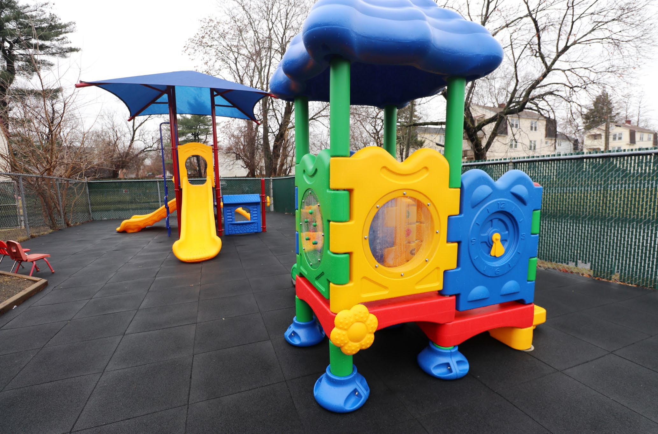
Site Control
Site control means you have a legal right to use and develop the property where your project will take place.
No application will be considered without such written assurance, and no grant will be awarded without either a mortgage, deed, or signed lease. If space is donated to the program, there should still be a legal document indicating program has exclusive use of the space and for how long.
Notes:
Owning the property,
Leasing the property with a long-term lease in place (with ability to renew for minimum of 10 years.)
The property is donated space for at least a 10 year time span.

Slide 9
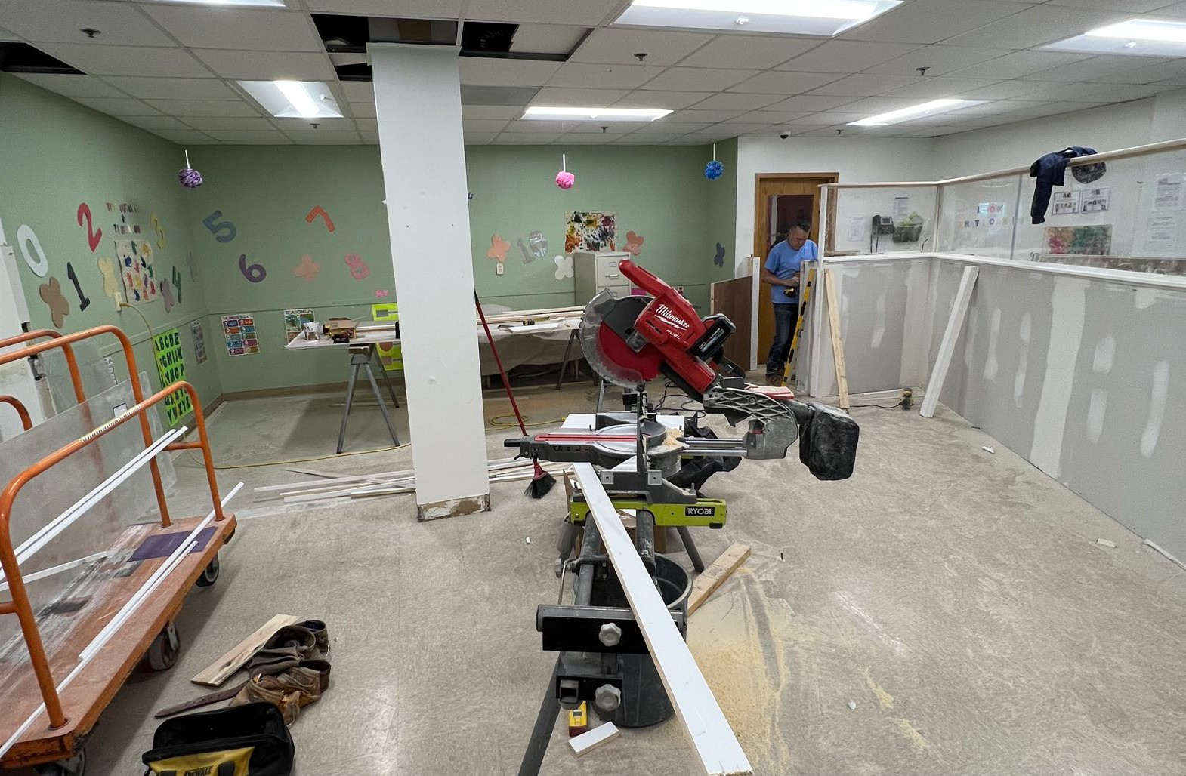
Shovel Ready
Pre-development in progress
Architectural plans have initial town approvals
Permits have been applied for or are in place
Contractors have been vetted
Project budgets are finalized or close to finalized
All necessary funding sources for project are secured
Notes:
Besides site Control, All preliminary site planning, architectural design, permitting, and zoning requirements must be in progress before receiving a grant.

Slide 10
Activities and Timeline
Oct. 20 – Nov. 7
Initial webinars and outreach
Oct. 20 – Nov. 7
Eligibility Survey opens
Nov. 10 – Dec. 12
Eligible projects invited to complete pre-application
Dec. 12 – Jan. 12
Up to 50 programs selected to move forward
Jan. 12 – Mar. 20
Finalists receive technical assistance (TA) and complete final application
March 20
Final applications due
April
Advisory Group reviews and selects 8-10 projects to receive a grant
April 2026 – January 2028
Grantees receive TA from LISC and WBDC to complete project
Notes:
--------------------------------------------
Step 1 - Outreach and Information Sharing ( October 20-November10)
It is important to attend one or more of the webinar opportunities. The meetings will clarify eligibility, program parameters, and give details of the selection process.
Grant Overview Webinar: One webinar will take place during the day and one in the evening. A recorded version of the webinar and all materials will be posted at ctbuildschildcare.org.
Frequently Asked Questions: FAQs will be available online and updated regularly.
Office Hours: Scheduled times will be available for live questions and answers.
Step 2 – Determine Eligibility (October 20th – November 10th)
Those who meet the eligibility guidelines will have access to the pre-application created and published by LISC along with TA to support application readiness.
Applicants who are not eligible will have an opportunity to add their name to a TA list for future funding opportunities and technical assistance.
Step 3 – Submit Pre-Application November 11th- Dec 15th
Applicants of eligible projects will receive an invitation to complete a pre-application form, which will ask for additional information about the project. Upon review of the pre-applications, 50 projects will move on to the final application phase. It is expected that 8 to 10 projects will be selected in April 2026.
Step 4-Project Review /Technical Assistance 8 weeks timeframe January 12- March 20th
The 50 finalist projects will be reviewed.
Additional documentation will be required to demonstrate project readiness,(including financials, project plans, letters of community support, etc. )
Potential projects will receive a site visit.
TA will be available for finalists to complete any aspects of the project not finalized including assistance with documents, financial readiness, and project readiness.
Step 5- Final Review, Narrative Application (March 20th- April 20^{th)}
Finalists who have met the “ready guidelines” as determined by LISC will be invited to submit the final application which will include a project narrative, additional project updates and requested information.
Step 6 External reviews (April 27th Reviews completed by Friday May 8th.)
8-10 projects will be chosen by the advisory board, through an external review process.
Other projects can still receive technical assistance to strengthen their project for other grant opportunities

Slide 11

Technical Assistance Opportunities and Coaching
Office Hours, Webinars and Open Communications
This type of TA will be provided as required by LISC, and as needed by grantees, and LOI finalists. The materials developed and strategies used will be the basis for a long- term Renovation and Construction TA program, available to interested providers.
WBDC Business Coaching
LISC CT will work with WBDC coaches and prospective grantees to ensure that grantees meet all eligibility requirements. Grantees will be coached throughout the grant process to ensure compliance and proper completion of the grant program.
*source: Child Care Business Support Program - WBDC
Notes:
Throughout the grant period Technical Assistance will be offered in various ways.
Webinars
Office hours
FAQ’s
Website: Ctbuildschildcare@lisc.org
Through Women’s Business Development Center

Slide 12

WBDC Technical Assistance Supports
One-to-One Guidance for LISC Grant
No-cost, individualized assistance to support you through the LISC grant process, from pre-application through post-award
Refining your project plan
Reviewing your budget & projections
Building your marketing plan
Refining your application responses
Accessing supplemental loans
Navigating grant compliance
Not quite ready to expand yet?
WBDC has supports to help you plan your expansion project to be ready for the next opportunity, from one-to-one advising and classes to resources and connections.
READY TO GET STARTED?
Contact the Women’s Business Development Council (WBDC) at:
childcarebusiness@ctwbdc.org
(203) 353-1750 x166
English & Spanish
WBDC has provided guidance to over 1,500 centers & homes, helping them strengthen their business and access over
$29 million in grants and loans.

Slide 13

For Office Hours, Future Webinars, and More Information Please Visit Our Website!
Website: Ctbuildschildcare@lisc.org
Email: OECfund@lisc.org
Notes:
We have time to take some questions. All responses and other FAQ's will be posted on the website.
Thank you , please check the website for more information and feel free to reach out with any additional questions to OECfund@lisc.org

Slide 14

What is a Prevailing Wage Requirement ?
Prevailing Wage Compliance
The DBA, passed in 1931, was the first Federal law to govern wage standards for non- government workers.
It requires the payment of locally prevailing wages and fringe benefits, as determined by DOL, to laborers and mechanics working for contractors and subcontractors engaged in Federal construction contracts.
Some projects may be subject to prevailing wage requirements.

Slide 15
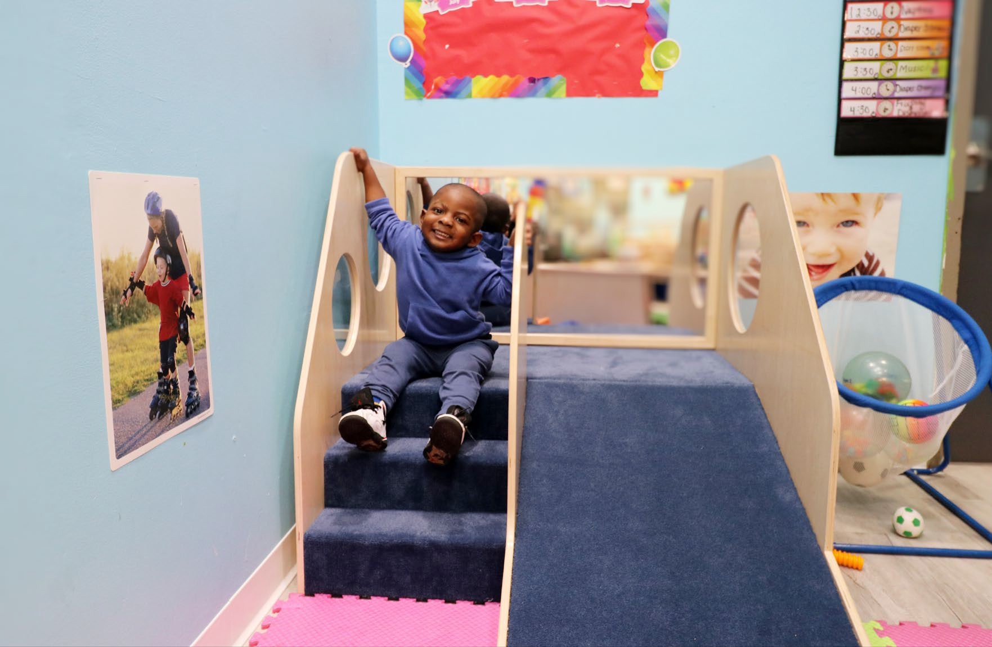
Criteria
Preference may be given based on the following
measurable criteria:
Level to which the project improves access to early childhood care and education in underserved communities, including increasing access to healthy, safe, and developmentally appropriate facilities for:
  Infant and toddler care.
  Preschool in areas defined as a child care desert.
Level to which applicant has demonstrated commitment to serving families with public subsidy.
Level at which the project is “shovel ready.”

Slide 16
Eligible Facility
Δ A building, structure, or site that is, or will be owned, leased or otherwise used by one or more eligible organizations and licensed or will be licensed (post-construction) by the Office of Early Childhood (OEC).
leased facilities have a lease term no less than 10 years including options*
Δ Lien Requirement - All grant recipients will be required to place a lien on the facility where grant-funded improvements are made. The lien must be filed in favor of the State of Connecticut to protect the state’s investment. Applicants must either:
Own the property outright and be able to file the lien, or
Have the legal authority/written approval from the property owner (e.g., landlord, lessor) to file the lien. Projects will not be eligible if a lien cannot be placed on the property should grant funds be awarded.
Δ A privately funded or non-profit program operating in a public school district building or publicly owned facility, may be eligible to receive a grant. Public School District projects are NOT eligible for this funding.

Slide 17
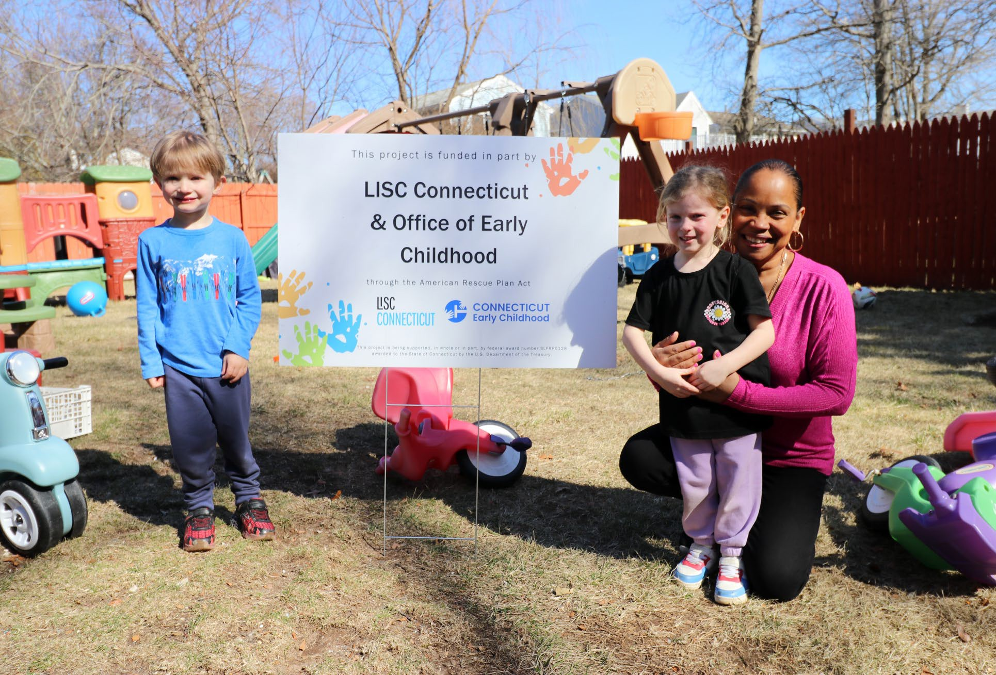
Eligible Project
The construction, renovation, rehabilitation or other capital improvement of an eligible, center- based facility.
The project must be intended to increase capacity of infants and toddlers and preschool in early care deserts. Projects that only include renovations and health and safety upgrades are not eligible.

Slide 18
How Does a Reimbursement Model Work?
If awarded funding, the written grant agreement with LISC will include a section called “Conditions to Disbursement of the Grant” – this section lists out the steps the grantee will need to take, and the documentation needed to request reimbursement for grant- funded expenses that they have paid. For example:
The grantee enters into an agreement with their contractor that outlines the work to be completed, and the payment schedule agreed to. A copy of the contract is sent to LISC. Work begins.
The contractor invoices the grantee based on the work/payment schedule.
The construction monitor reviews the work being invoiced prior to payment and provides written approval that the invoice accurately reflects work completed by the contractor.
The grantee pays the contractor.
The grantee then submits required documentation to LISC to be reimbursed for that payment (for example, this documentation may include copies of: the contractor's invoice; the construction monitor's approval; and proof of payment to the contractor such as a cancelled check or bank statement).
LISC processes the reimbursement request – payments take approximately 10 to 15 business days to be deposited to grantee's bank.
Grantees must retain all grant-related documentation (e.g., signed grant agreement with LISC; documented procurement process for hiring their contractor; final, signed contract with the contractor; copies of ALL invoices, receipts, and statements for grant-related expenses; and proof of payment for all grant-funded expenses).

Slide 19

Reimbursement Model
Plan for covering grant-funded expenses up front while awaiting reimbursement.
Demonstrated ability to manage cash flow to cover project expenses before reimbursement (i.e. access to working capital like business reserves, line of credit, bridge financing, partner support, etc.)
Funds spent on the grant-funded project after the date of the execution of the LISC grant agreement shall be eligible for reimbursement.

Slide 20
Women’s Business Development Council Supports
No-cost, individualized bilingual assistance to support you through the LISC grant process, from pre-application through post-award
  Refining your project plan
  Building your marketing plan
  Reviewing your budget & projections
Not yet ready to expand your slots just yet? We have supports to help you plan your project to be ready for the next opportunity, from 1:1 advising to classes.
WBDC has provided guidance to over 1,500 centers & homes across CT, helping them strengthen their business and access over $29 million in grants and loans.
  Refining your application responses
  Accessing supplemental loans
  Navigating grant compliance
To get started, contact WBDC at:
childcarebusiness@ctwbdc.org or 203.353.1750 x166

